Slide 1
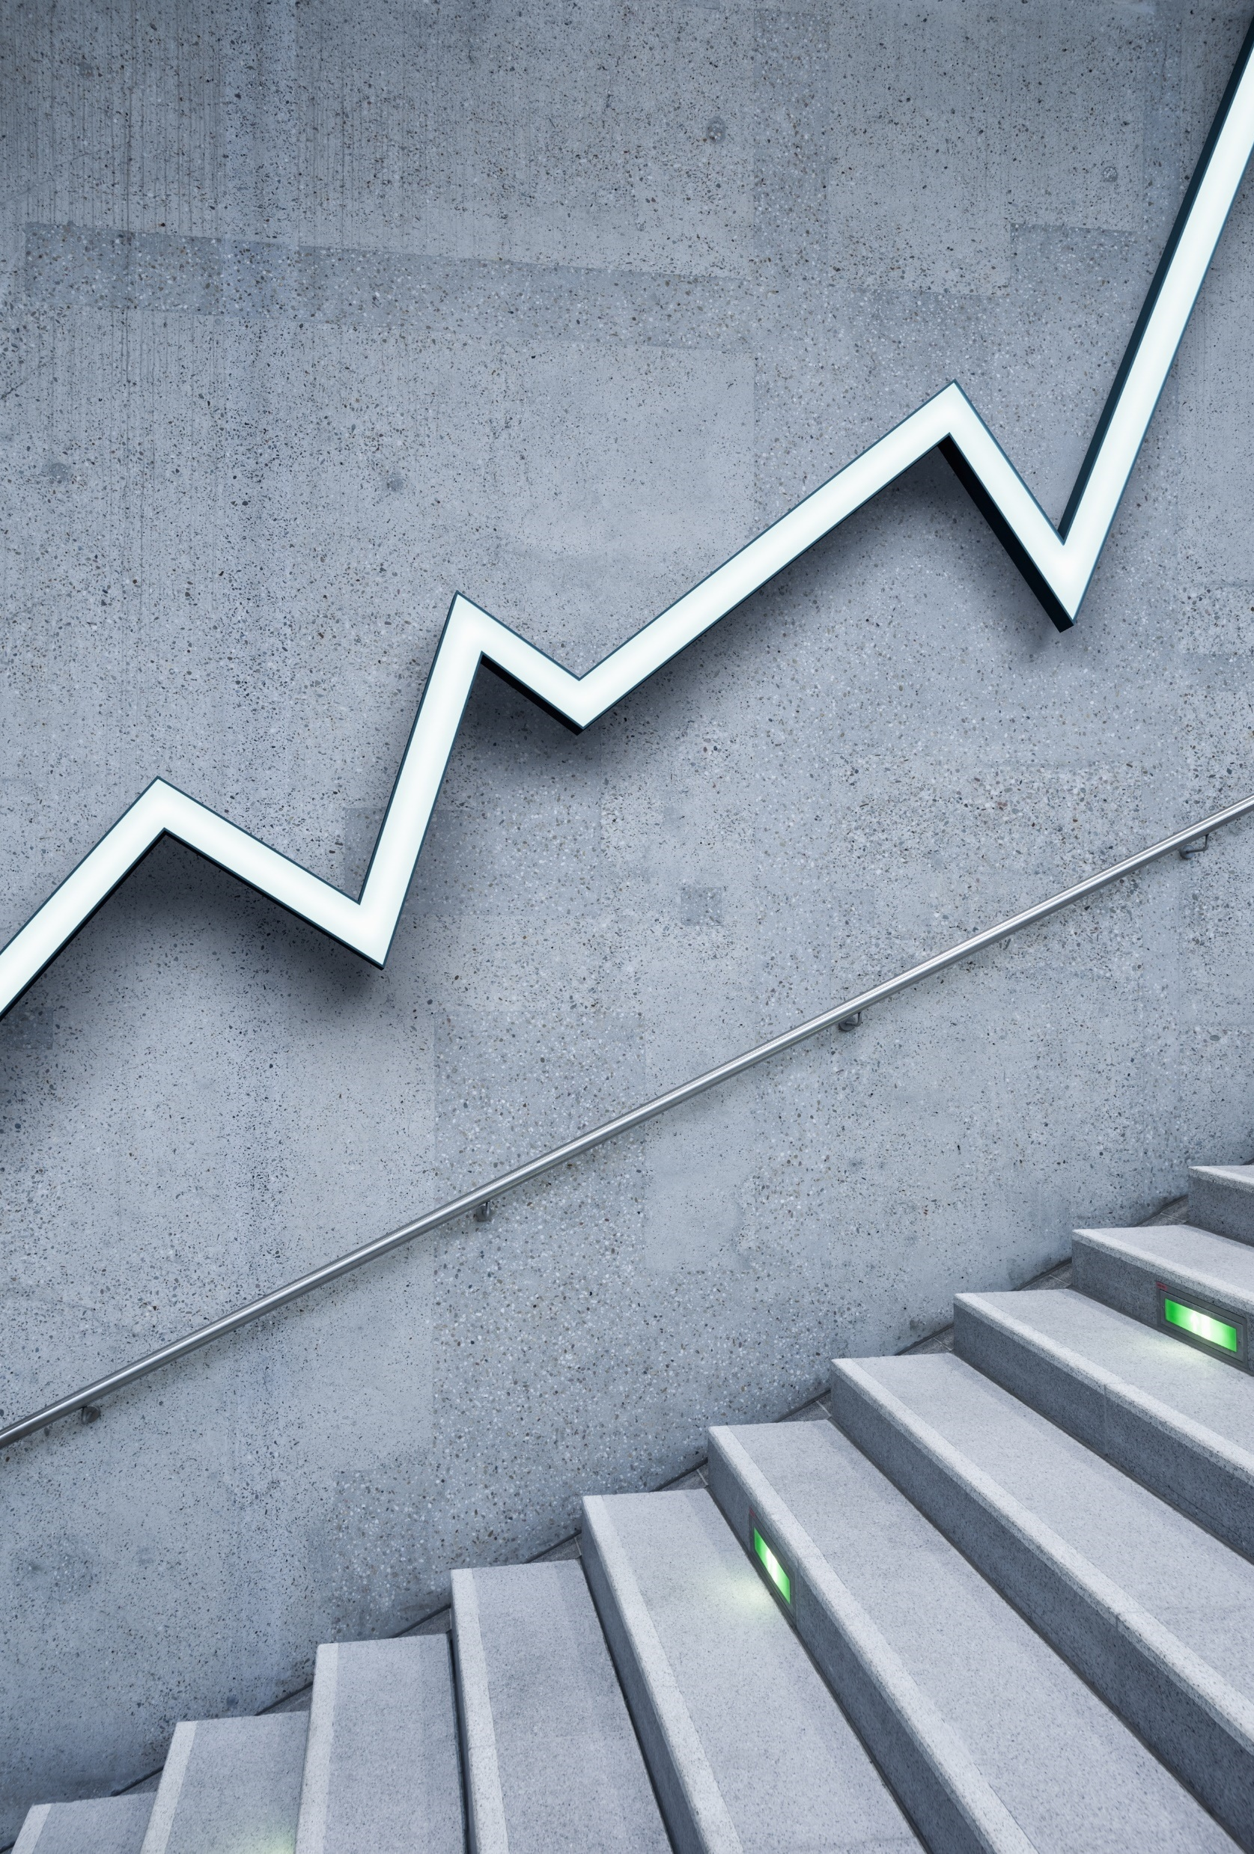
Stock Prediction with XGBoost
Alex Wutzke, cpa

Slide 2
About Me
Bachelor of Commerce from University of Calgary
Earned my CPA at a public accounting firm
Interested in programming and data science
I like canoeing, paragliding, and video games

Slide 3
Inspiration
Solidifying my data manipulation skills
Working with state-of-the-art machine learning algorithms on a genuinely difficult challenge
Creating a strategy that I can use in the future

Slide 4
Strategy
RSI
Output = 0 or 1
1 = >+5% over 10 days
0 = <+5% over 10 days
Technical indicators
Classification Model
SMA
MACD

Slide 5
Feature Engineering
Research
- Relative Strength index (RSI)
- Simple moving average (SMA)
- Moving Average Convergence Divergence (MACD)
- Abnormal volume
Build
- Developed functions to calculate metrics
- Flexible to allow adjustments
Optimize
- Correlation matrix
- Tweaking features to maximize correlation with target

Slide 6
Train and Test Data
Training Data
Test Data
2015 - 2019
2020 to date
Top 150 largest companies on TSX
5 technical indicators
~28,000 examples
Top 150 largest companies on TSX
5 technical indicators
~ 133,000 examples

Slide 7
XGBoost Classifier
Fast and accurate
Has been used to win lots competitions
Lately, it has been popular for stock prediction
Outputs a useful prediction probability

Slide 8
Results
Data | Overall Accuracy | Precision (% correct positive identifications) | Recall (% true positives were correctly identified) | Average gain of positive identifications
Train (2015-2019) | ~82% | 98.3% | 11.2% | 15.4%
Test (2020-Current) Confidence > 50% | ~72% | 56.6% | 8.4% | 8.8%
Test (2020-Current) Confidence > 30% | ~68% | 42.2% | 32.5% | 2.9%
Positive identification = Stock will go up >5% in 10 trading days

Slide 9
Can you make money with it?

Slide 10
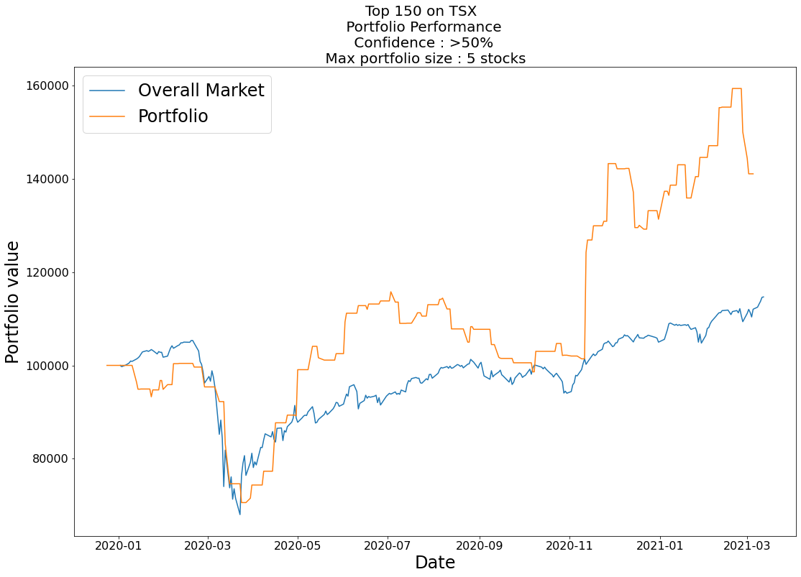
Market performance = +14.7%
Model performance = +41.1%

Slide 11
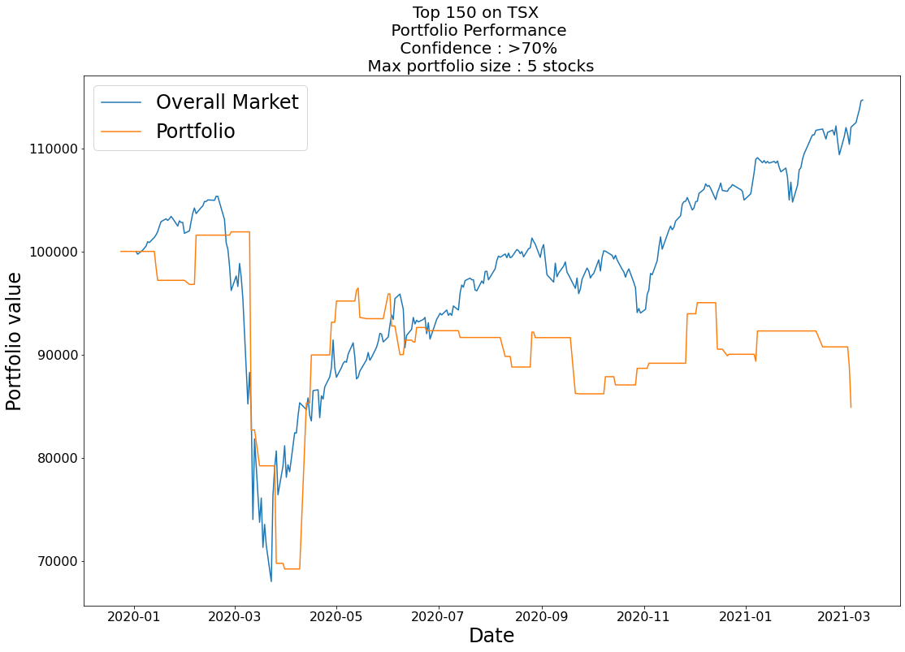
Market performance = +14.7%
Model performance = -15.1%

Slide 12

Going Forward
Add more information about the overall market
Industry specific models (Healthcare, oil & gas, precious metals)
Deployment to Alpaca

Slide 13
Thanks!

Slide 14
APPENDICES

Slide 15
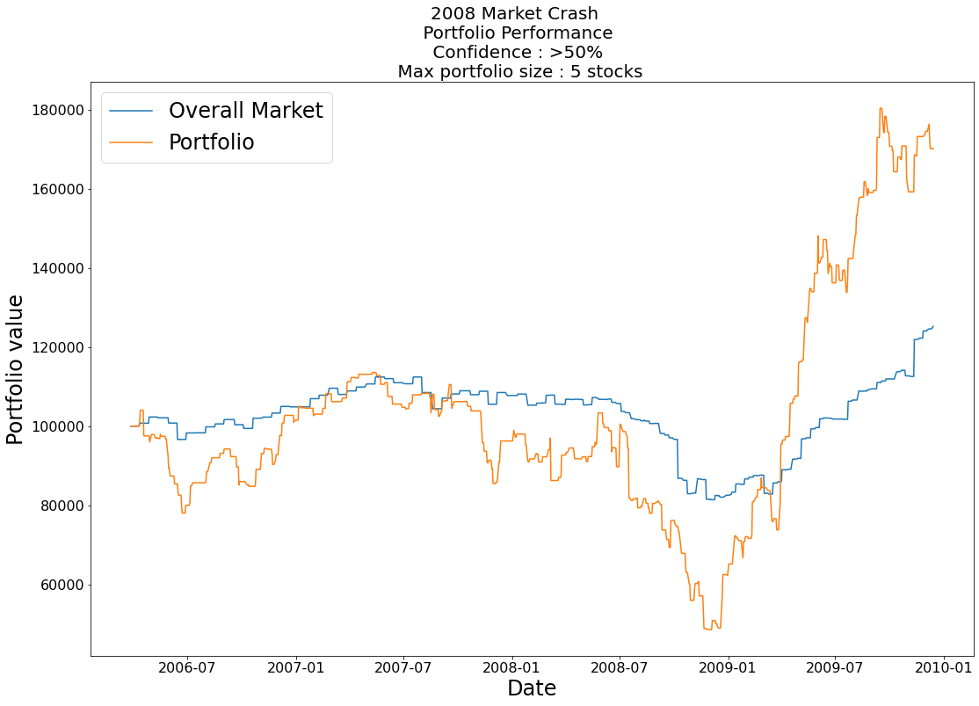

Slide 16
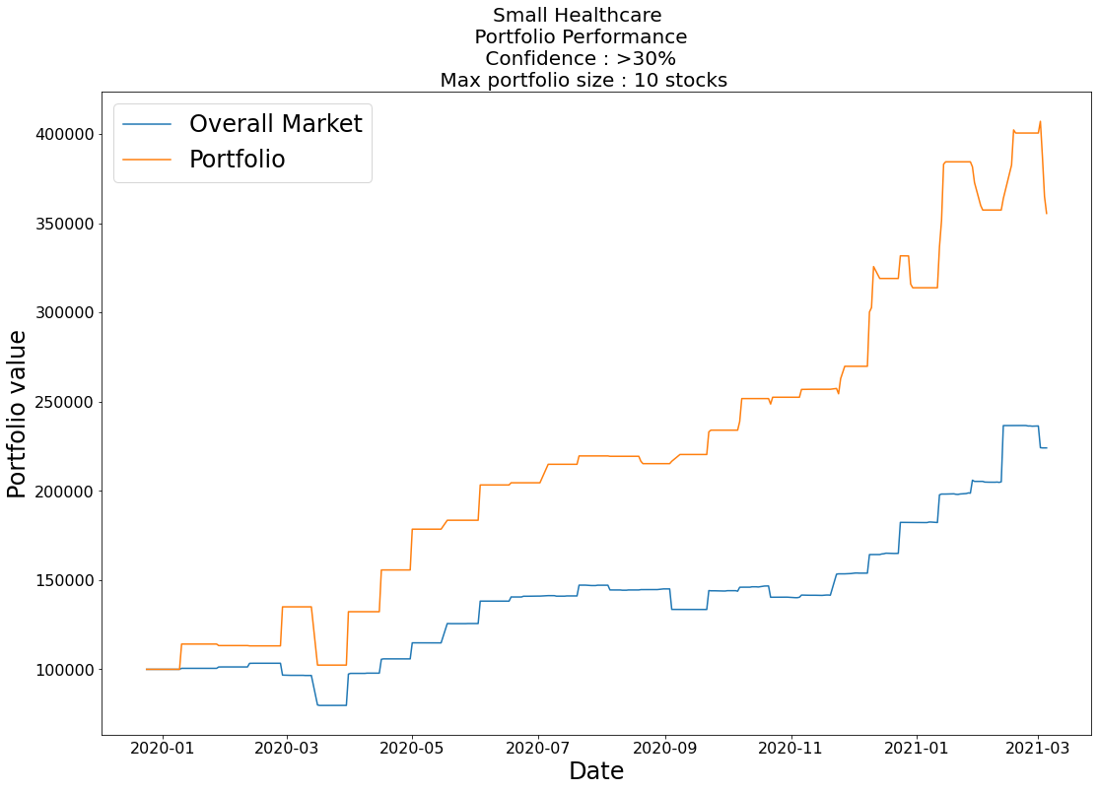
Market performance = ~200%
Model performance = ~350%

Slide 17
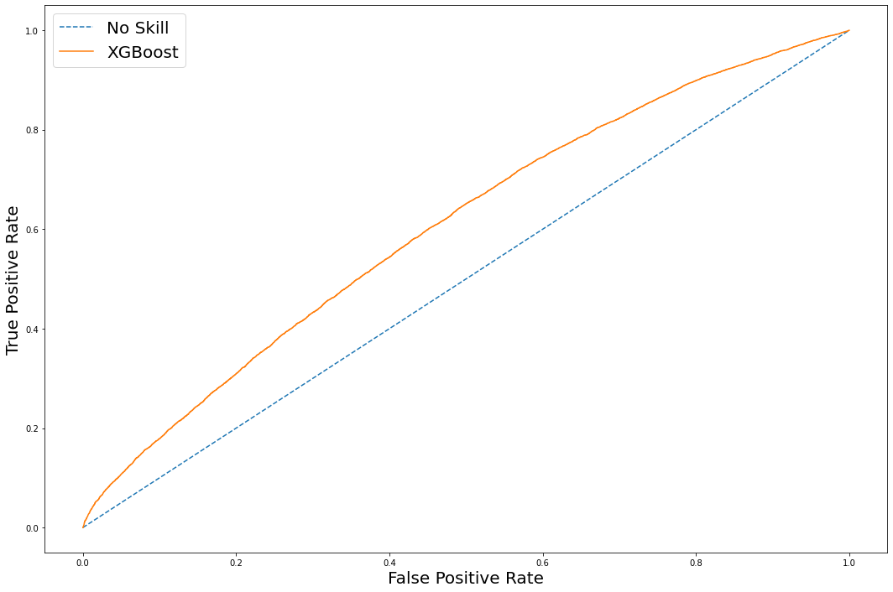
AUC = 0.606

Slide 18
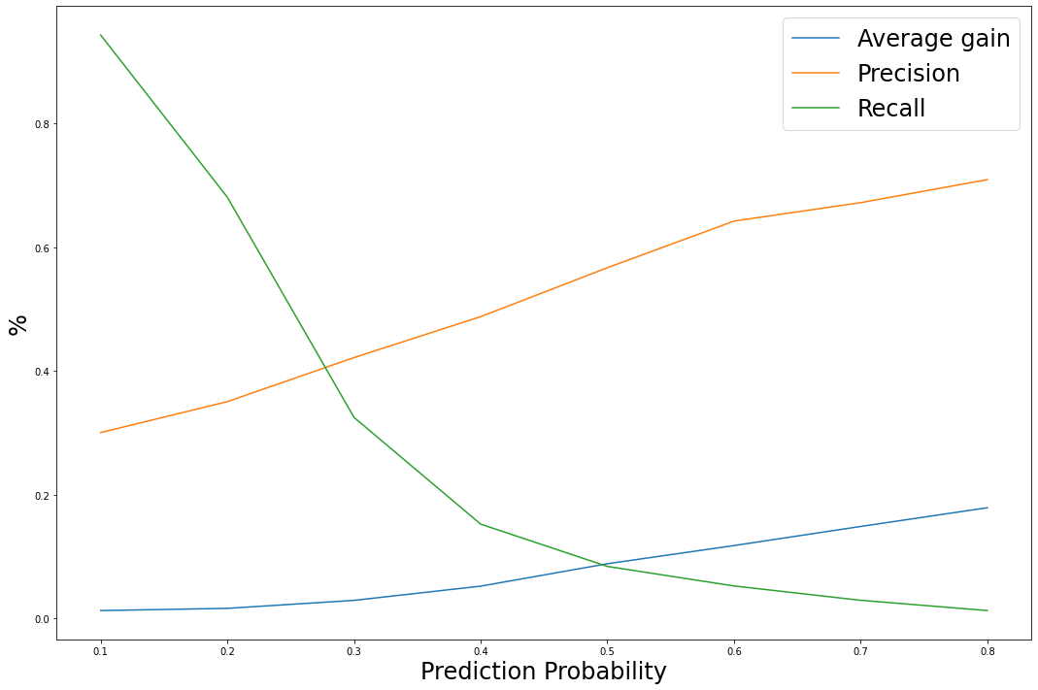
Trade-off between precision and recall

Slide 19
What did the model learn?
 | 10-day SMA | 14-day RSI | 30-day Force Index | MACD between 5-day and 10-day | 5-day change in MACD
Confidence > 50% | 94% | 43% | -35% | -5.8% | -2.6%
Confidence < 50% | 100% | 54% | 4.5% | 0.01% | 0.01%
Model is predicting high confidence that the stock will go up when:
Stock is oversold (lower RSI)
Stock has declined over the last 30-days with high volume (Force Index)
MACD negative and declining

Slide 20
Current predictions (as of today)
Small US Tech Companies:
Stock ticker | Prediction confidence
SOL | 0.624
PRTH | 0.616
VERI | 0.613
MTLS | 0.573
ATOM | 0.564

Slide 21
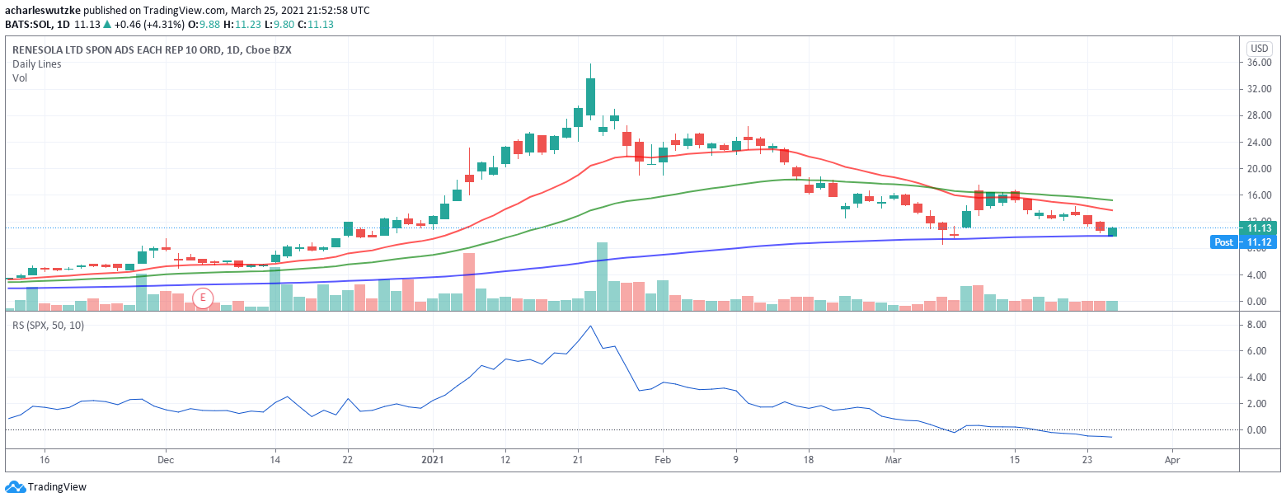

Slide 22
